Slide 1
NP-Complete-Case Studies
Dr. Bhawana Rudra
NITK

Slide 2
We say that an algorithm solves a problem in polynomial time if its worst-case time efficiency belongs to O(p(n)) where p(n) is a polynomial of the problem’s input size n.
Note that since we are using big-oh notation here, problems solvable in, say, logarithmic time are solvable in polynomial time as well.
Problems that can be solved in polynomial time are called tractable, and problems that cannot be solved in polynomial time are called intractable.

Slide 3


Slide 4
Consider NP problems as the base set, i.e simply,a set consisting of those problems which have polynomial time solutions but using non deterministic algorithms.
The region named P here is the set of polynomial time problems,i.e, those problems for which algorithms exist that can solve it in polynomial time. Note that this region is a subset of NP problems.
The problems in P were once in NPi.e they had non deterministic algorithms, but we were able to decipher them and so these problems became P.
NP complete problems are the intersection region of NP prolems and NP Hard problems.
NP complete problems are those problems that have a polynomial time solution but this is derived using a non-deterministic algorithm.
If an NP hard problem does not have a non deterministic algorithm, then it is not NP complete, it remains NP Hard.
When there exists a deterministic algorithm for the NP problem, it is classified as P problem. When there exists a non deterministic algorithm for the problem, it is classified as NP complete.
Note that NP forms the base class of all types of problems except some NP hard problems.
You can see in the diagram above that there is a section of NP hard problems that does not fall in the NP region.

Slide 5
Hamiltonian circuit problem Determine whether a given graph has a Hamiltonian circuit—a path that starts and ends at the same vertex and passes through all the other vertices exactly once.
A Hamiltonian circuit is a circuit that visits every vertex once with no repeats. Being a circuit, it must start and end at the same vertex.
A Hamiltonian path also visits every vertex once with no repeats, but does not have to start and end at the same vertex.

Slide 6
Traveling salesman problem Find the shortest tour through n cities with known positive integer distances between them (find the shortest Hamiltonian circuit in a complete graph with positive integer weights).

Slide 7
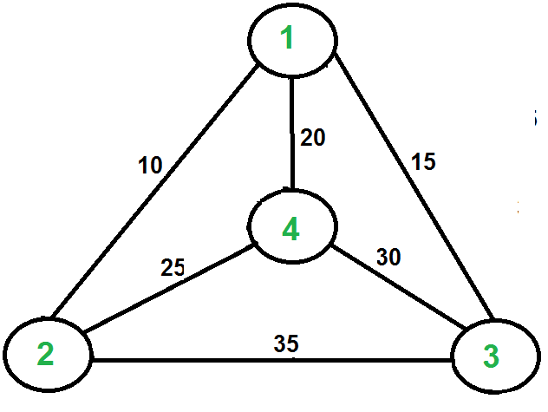

Slide 8
A TSP tour in the graph is 1-2-4-3-1. The cost of the tour is 10+25+30+15 which is 80.
The problem is a famous NP-hard problem.
There is no polynomial-time know solution for this problem

Slide 9
Naive Solution:
1) Consider city 1 as the starting and ending point.
2) Generate all (n-1)! Permutations of cities.
3) Calculate the cost of every permutation and keep track of the minimum cost permutation.
4) Return the permutation with minimum cost.
Time Complexity: Θ(n!)
Dynamic Programming:
Let the given set of vertices be {1, 2, 3, 4,….n}. Let us consider 1 as starting and ending point of output. For every other vertex I (other than 1), we find the minimum cost path with 1 as the starting point, I as the ending point, and all vertices appearing exactly once.
Let the cost of this path cost (i), and the cost of the corresponding Cycle would cost (i) + dist(i, 1) where dist(i, 1) is the distance from I to 1. Finally, we return the minimum of all [cost(i) + dist(i, 1)] values. This looks simple so far.
Now the question is how to get cost(i)? To calculate the cost(i) using Dynamic Programming, we need to have some recursive relation in terms of sub-problems.

Slide 10
Applications
problems are often tackled with rules-based languages in areas including:
Approximate computing
Configuration
Cryptography
Data mining
Decision support
Phylogenetics
Planning
Process monitoring and control
Rosters or schedules
Routing/vehicle routing
Scheduling

